Slide 1
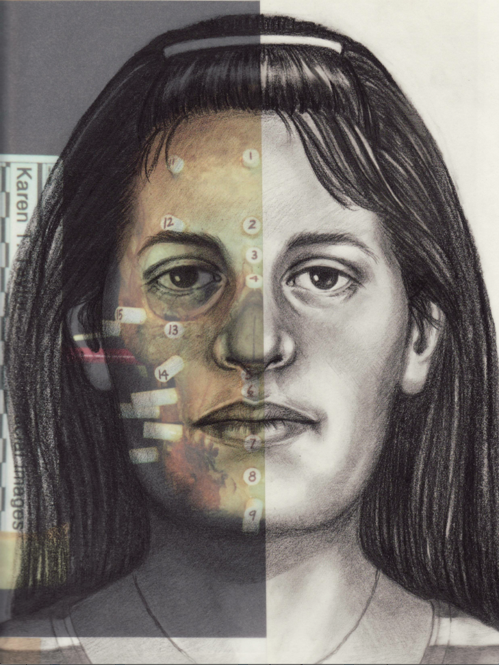
FORENSIC FACE SKETCH CONSTRUCTION ANd RECOGNITION
Presented By,
BLESSY P ROY
TKM20MCA-2014
Internal Guide,
ALSHAINA S

Slide 2
CONTENTS
Introduction
Related Works
Gap Identified
Problem Statement
Objectives
Methodology
Result & Conclusion
Future Enhancement
Reference
Screenshots

Slide 3
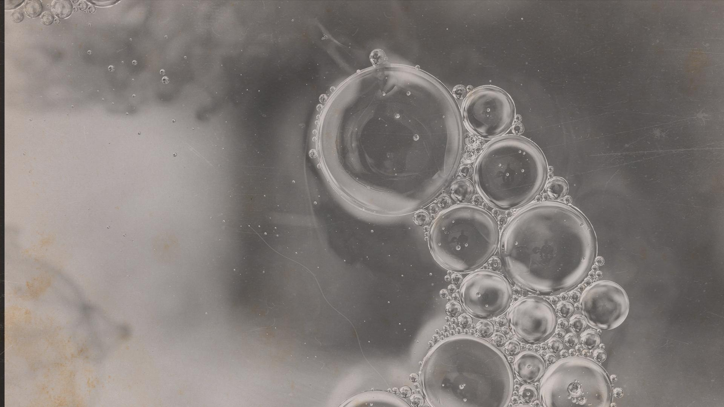
introduction
In forensic science, it is seen that hand-drawn face sketches are still very limited and time consuming .
Forensic Face Sketch Construction and Recognition is a standalone application which would allow users to create composites face sketch of the suspect without the help of forensic artists.
Sketch drawn using drag and drop feature in the application and predict the drawn composite face sketch with the dataset.

Slide 4
Related works
Sl .No | Title and Publisher | Year of Publisher | Prons | Cons
1 | “Composite Sketch Based Face Recognition Using ANN Classification” ,Shivaleela Patil, D., & Shibhangi, D. C. International Journal of Scientific and Technology Research, 9, 42–50. | 2020 | Artificial Neural Network (ANN) Provides better results for composite sketches rather than forensic sketches | The detection results depend on weak classifiers and detection results often have many false positives
2 | “ Deep sketch-photo face recognition assisted by facial attributes.”, Iranmanesh, S. M., Kazemi, H., Soleymani, S., Dabouei, A., & Nasrabadi, N. M. Proceedings of IEEE 9th International Conference on Biometrics Theory, Applications and Systems (BTAS). | 2018 | Joint Loss function . Facial attributes such as eye, hair,skin color and ethnicity were considered | It could not recognize the face in different angle or direction.

Slide 5
3 | “Attribute centered loss for soft-biometrics guided face sketch-photo recognition”. Kazemi, H., Soleymani, S., Dabouei, A., Iranmanesh, M., & Nasrabadi, N. M. .Proceedings of the IEEE Conference on Computer Vision and Pattern Recognition | 2018 | Attribute centered loss function The model used here will learn the deep features between sketch and photo | It contain less amount of facial characteristics.
4 | “Real time face recognition system (RTFRS).”Haji, S., & Varol, A. Proceedings of 4th International Symposium on Digital Forensic and Security (ISDFS). | 2016 | Local Binary Patterns Eliminates the light exposure on facial images | Feature descriptors is that might not be the optimal features for the task of sketch-photo recognition.

Slide 6
GAp Identified
The traditional approach here is to use the hand-drawn face sketches drawn by forensic sketch artist to identify the criminal, modernizing this would mean using the hand-drawn sketch and then matching them with the law enforcement departments database to identify the criminal.
Time Consuming

Slide 7
Problem statement
Proposed system create composite sketch and then predict the matching of this sketch with the real image using VGG16.
Forensic

Slide 8
objective
This is a standalone application, allowing user to construct accurate composite face sketch using the predefined facial feature sets provided as tools that can be resized and repositioned as per requirement/described by the eye-witness.
Moreover, the constructed composite face sketch be matched with the dataset using deep learning.

Slide 9
Methodology
Sketch
Recognition
Using that created sketch, the real image of suspect can be predicted by VGG16 architecture.
This module of the project mainly focuses on creating a face sketch based on the description been provided by the Eye Witness.
Human face is categorized into various facial features such as head, eyes,eyebrow, lips, nose, ears, etc.
The elements can be easily create a described face sketch of the suspect using the features by drag and drop in order to arrange the elements.

Slide 10
VGG16
VGG16 is a type of CNN (Convolutional Neural Network) that is considered to be one of the best computer vision models to date.
Only 3x3 convolutions, but lots of filters. Trained on 4 GPUs for 2–3 weeks. It is currently the most preferred choice in the community for extracting features from images.
The weight configuration of the VGGNet is publicly available and has been used in many other applications and challenges as a baseline feature extractor. However, VGGNet consists of 138 million parameters, which can be a bit challenging to handle.

Slide 11
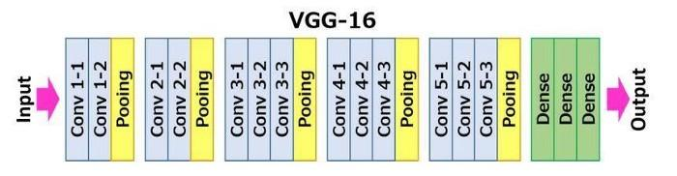

Slide 12
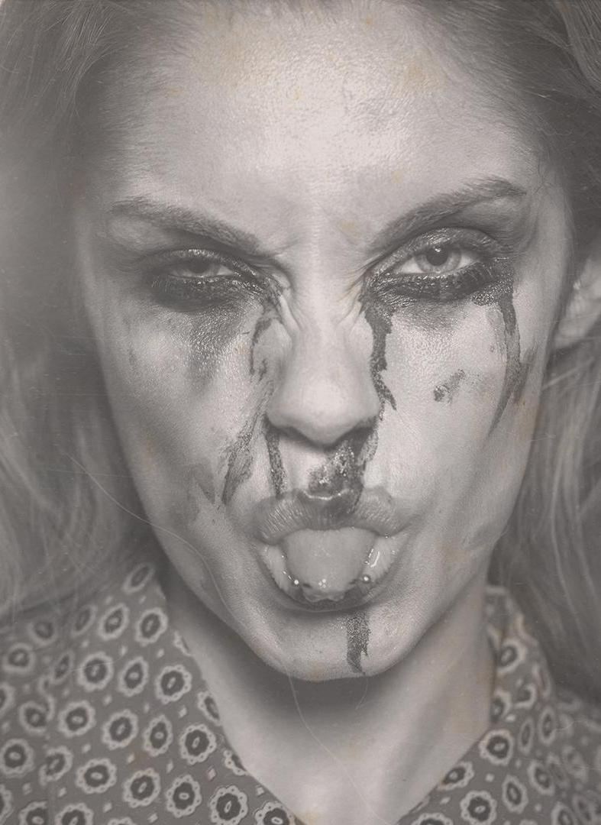
Dataset used:
CUHK
Face Sketch database (CUFS) is for research on face sketch synthesis and face sketch recognition.
There are 606 faces in total.
For each face, there is a sketch drawn by an artist based on a photo taken in a frontal pose, under normal lighting condition, and with a neutral expression.

Slide 13
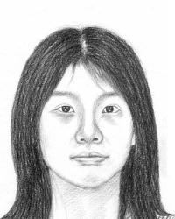


Slide 14
Result and conclusion
Using the standalone application we can create the criminal sketch without any help of forensic artists.
We can easily find the digital image of criminal using the sketch.

Slide 15
Future enhancement
The platform can be much enhanced in the future to work with various technologies and scenarios enabling it to explore various media and surveillances medium and get a much wider spread and outputs.
The platform can be modified to match the Face sketch with the human faces from the video feeds by using the 3D mapping and imaging techniques and same can be implemented to the CCTV surveillances to perform face recognition on the Live CCTV footage using the Face Sketch.

Slide 16
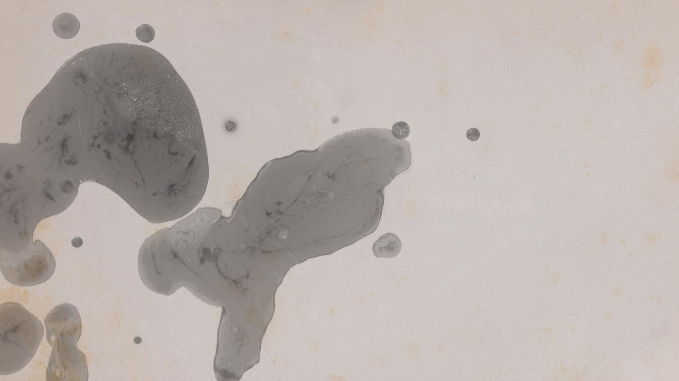
Reference
[1] Chethana H. T., Vidyavardhaka College of Engineering, Mysuru, India “A New Framework for Matching Forensic Composite Sketches With Digital Images” Trisiladevi C. Nagavi, S. J. College of Engineering, JSS Science and Technology University, Mysore, India International Journal of Digital Crime and Forensics Volume 13 Issue 5 :September-October 2021
[2] Fakhar Ullah Mangla & Muzammil Shahzad & M. IkramUllah Lali & Syed Ahmad Chan Bukhari”Sketch-based facial recognition: a weighted component-based approach (WCBA)”Received: 9 April 2019 /Revised: 16 June 2020 /Accepted: 24 June 2020
[3] Bin Sheng, Ping Li, Chenhao Gao, Kwan-Liu Ma, "Deep Neural Representation Guided Face Sketch Synthesis", IEEE Trans. Vis. Comput. Graph., vol. 25, no. 12, pp. 3216-3230, Dec.2019
[4] Hamed Kiani Galoogahi and Terence Sim, “Face Sketch Recognition By Local Radon Binary Pattern: LRBP”, 19th IEEE International Conference on Image Processing, 2012.
[5] FACES 4.0, IQ Biometrics, http://www.iqbiometrix.com.

Slide 17
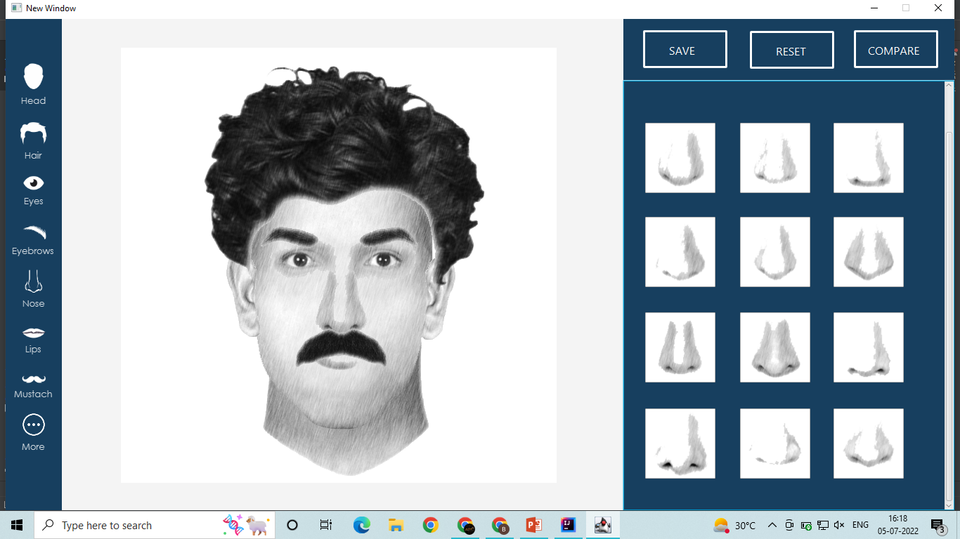
screenshot

Slide 18
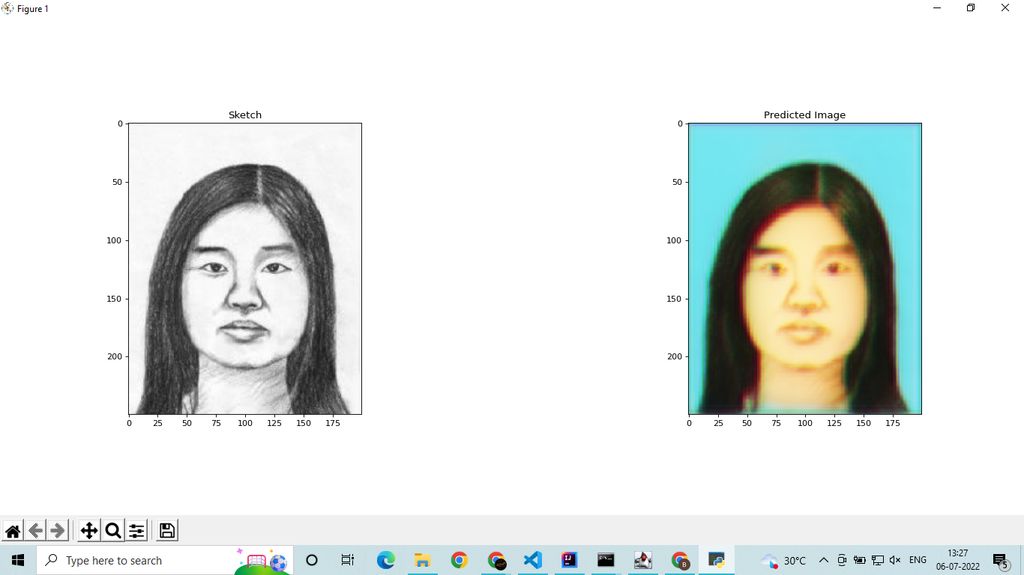

Slide 19

THANKS

